Slide 1

Research for your assignment

Slide 2
Introduction
An essay is an opportunity for you to show what you have learned.

Slide 3
A good essay requires you to:
Show a clear understanding of what the question (essay topic) asks.
Carry out research to gather information and sources which will support the argument or opinion which you will be conveying in your essay.
Write your essay in a clear, concise and compelling manner.
Practice good time management.
Include a bibliography of the resources consulted.

Slide 4
Steps along your journey from selecting the topic to preparing to write your essay
Step 1: Topic Analysis
Step 2 Researching resources for your assignment
Step 3: Preparing to write your assignment:

Slide 5

Step 1: Topic Analysis
Defining your topic / unpacking the topic / thinking about the assignment
Questions to ask before you begin ...
What am I being asked to do?
What is the question asking?
Do I understand what I am being asked to do?
What are the key ideas we have covered in class?
How does this assignment link to what we have heard in class?
How can I use these ideas?

Slide 6
Step 1: Topic Analysis
TASK WORDS tell you what you need to do
  (Examples = Analyze. Evaluate. Discuss.)
CONTENT WORDS tell you what you need to research
LIMITING WORDS tell you the restrictions which apply to your research

Slide 7
Step 1: Topic Analysis
Sample assignment tasks
Critically evaluate the contribution of liberation theology to Christology
Assess the contribution of liberation theology to Christology
Clarify what is liberation theology in relation to Christology
Discuss the benefits and challenges of liberation theology to Christology
This process will provide you with some Key Words to use as you begin your RESEARCH

Slide 8

Step 1: Topic Analysis
In your quest subject site,
you will find a list of TASK WORDS
and their meanings

Slide 9
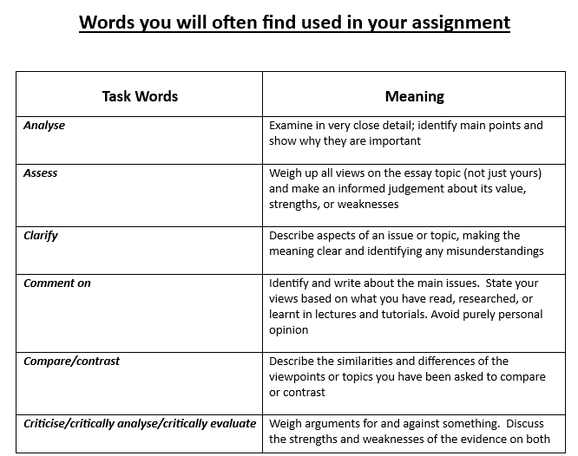

Slide 10
Step 2: Research for your assignment
Gathering resources which will enable you to write your assignment
Some guidelines to help you start your research:
Use your Key Words to begin searching for information which will help you write your assignment
Have you looked at the readings in quest? What readings can help you for this assignment?
What are the resources you can find in Camden Theological Library?
Make a note of what you consider are the main points in each resource at the time you consult the resource

Slide 11

Step 2: Research for your assignment
These are the Building Blocks for REFERENCING
WHO? wrote the resource
WHAT? is the title of the resource
WHEN? is the date of the resource
WHERE? is the place where the resource was published
AND details of page numbers, journal volumes and issue numbers
TIP: Take details of every resource you consult at the time you consult the resource!

Slide 12
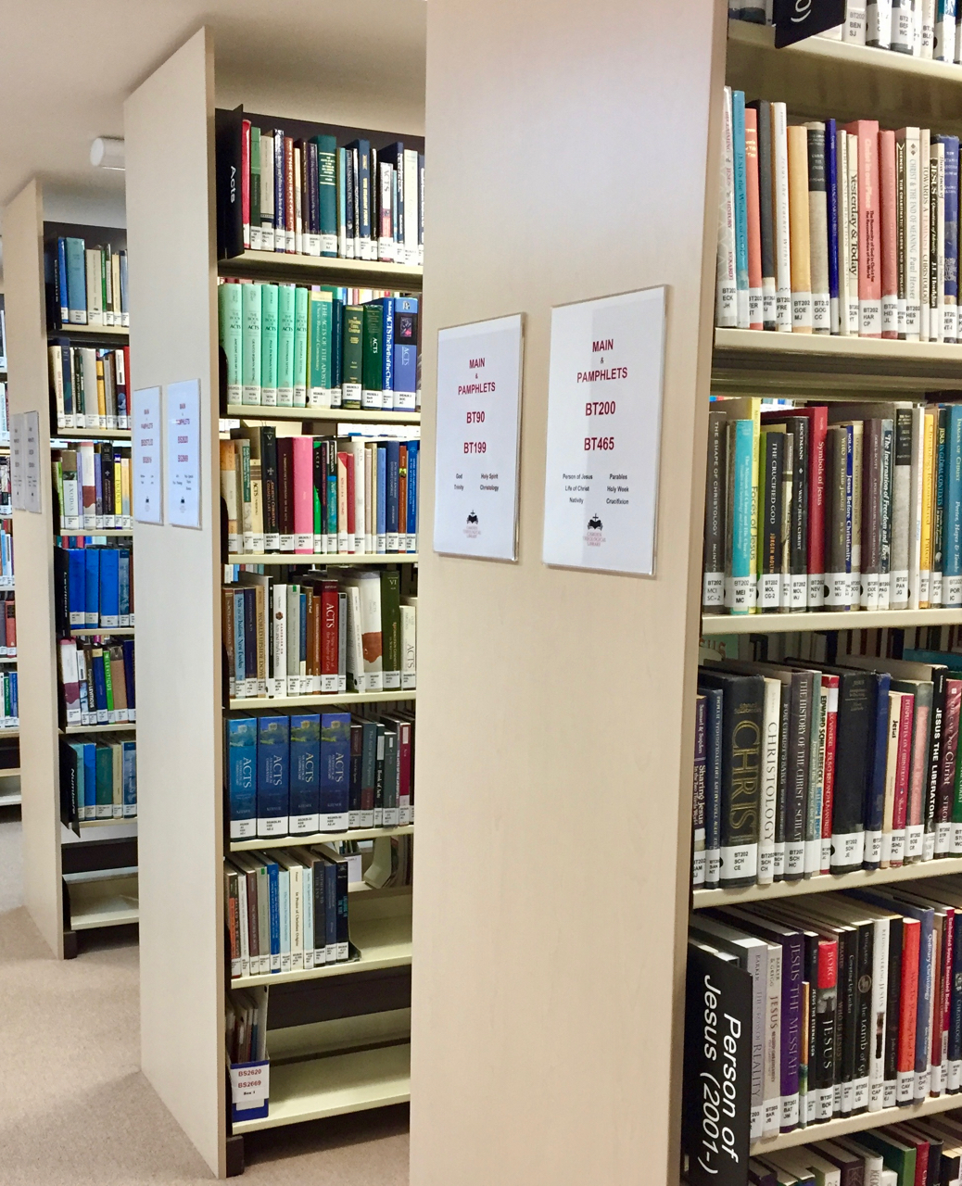


Step 2: Research for your assignment
WHAT & WHERE to begin your research
The staff of Camden Theological Library
=
seek their expert assistance

Slide 13
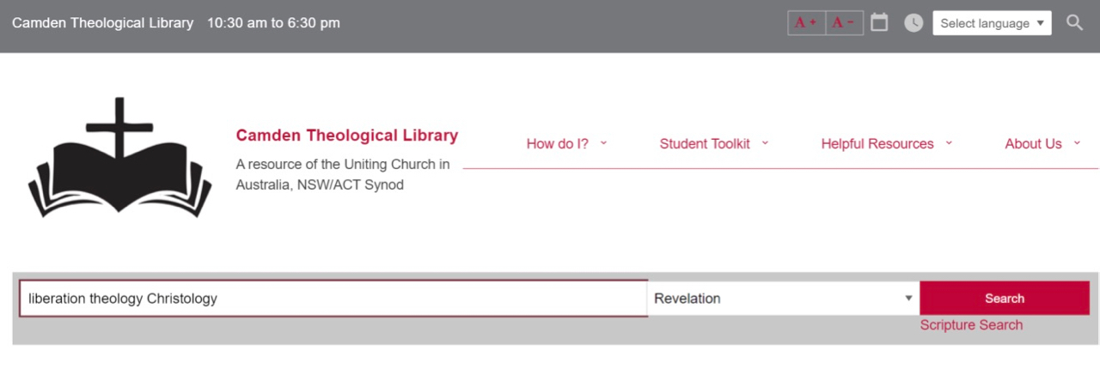

Step 2: Research for your assignment
WHAT & WHERE to begin your research
Revelation search: This is an entry point for gathering sources for essays.
When you use your Key Words, they will help you find relevant:
  Books - print and eBooks
  Full text Journal articles

Slide 14

Types of sources
Researchers deal with three main types of sources:
  Primary sources
  Secondary sources
  Reference sources

Slide 15
Primary sources
These are sources which originate from the time and place of the events being investigated.
They can include contemporary letters, documents etc.
  Historical documents such as the Bible
  Works of the Church Fathers
  Other contemporary documents.

Slide 16
Secondary sources
Secondary sources analyze, evaluate or interpret information contained in primary and other secondary sources.
  Books
  Journal articles
  Other scholarly works

Slide 17

Reference sources
These are publications that compile, analyze or summarize primary and secondary sources.
They often provide summaries of complex subjects.
They may contain suggestions for further reading.
  Encyclopedias
  Dictionaries
  Concise Biblical commentaries

Slide 18
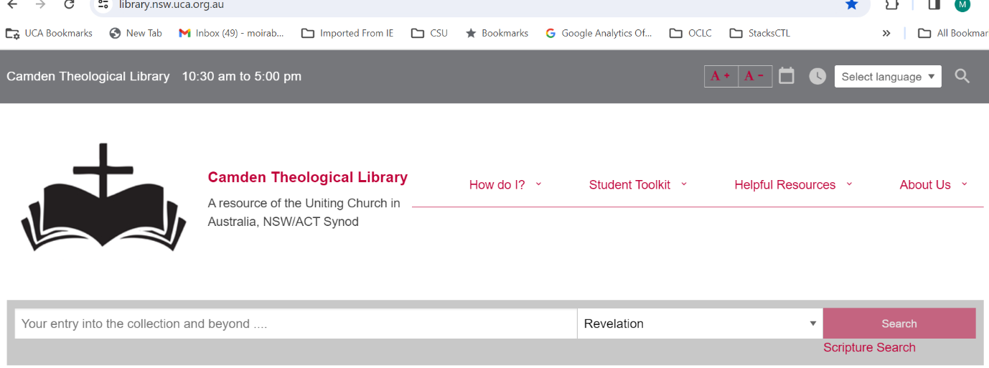
Revelation
This is an entry point for gathering sources for essays.

Slide 19
Reference resources
It is sometimes best to begin your research for an assignment in the library's reference collection. Below are some of the key resources that will help get you off to a good start with your assignment. There are many more useful books in addition to these. Please ask library staff to assist you to find the right resource to help you.

Slide 20

Biblical Studies :
Useful Reference Books
    Commentaries

Slide 21
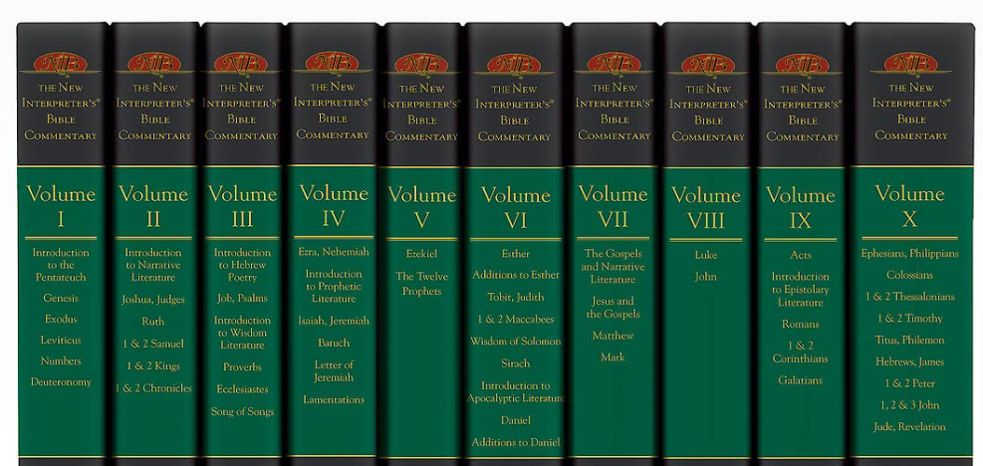

Slide 22
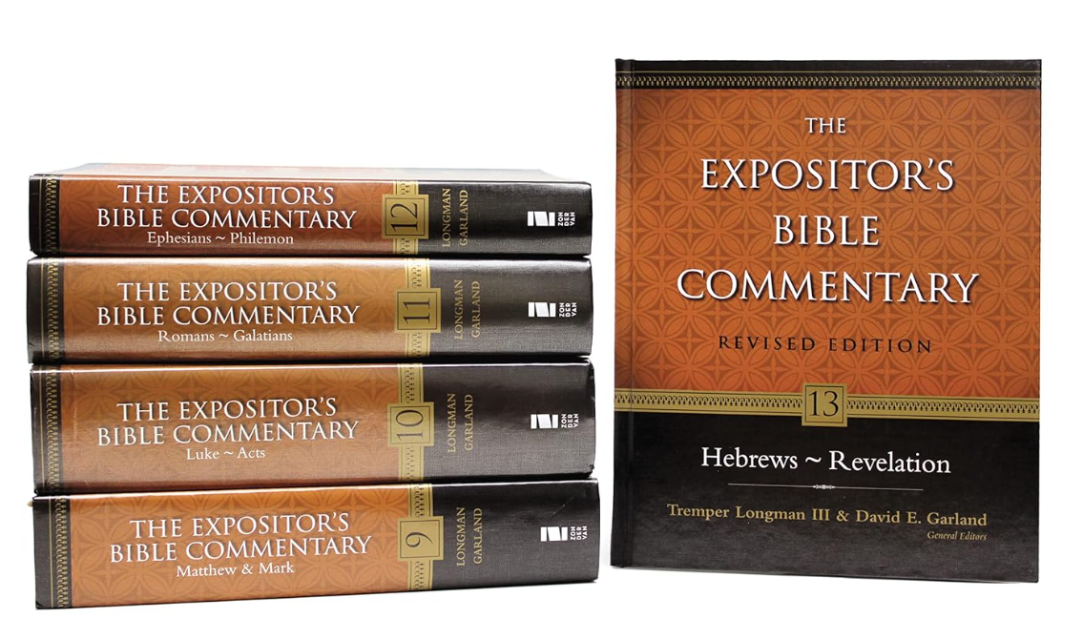

Slide 23
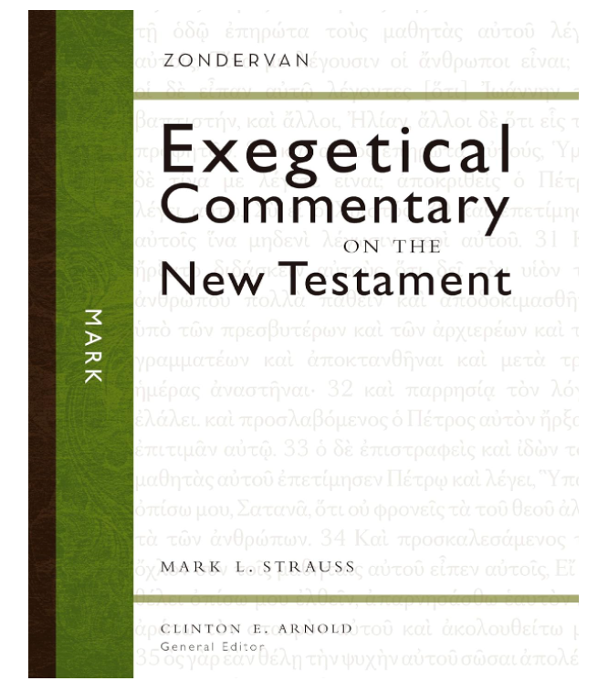

Slide 24
Biblical Studies :
Useful Reference Books
Dictionaries & Encyclopaedias

Slide 25
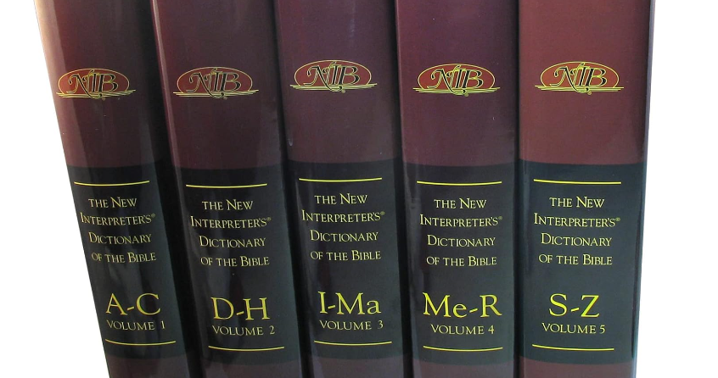

Slide 26
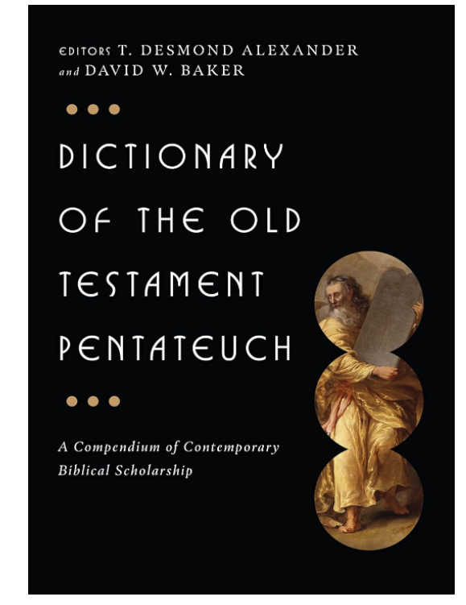

Slide 27
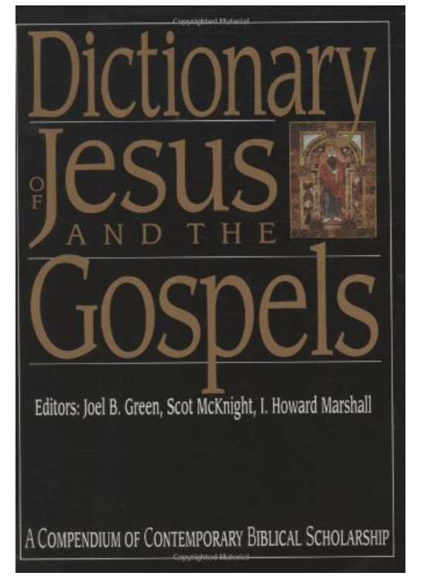

Slide 28
Theology :
Useful Reference Books
Dictionaries & Encyclopaedias

Slide 29
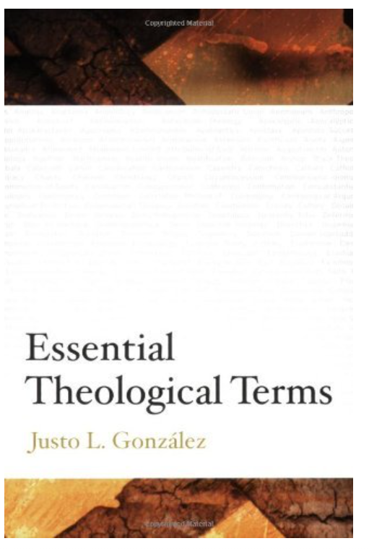

Slide 30


Slide 31


Slide 32


Slide 33
Church History :
Useful Reference Books
Dictionaries & Encyclopaedias

Slide 34
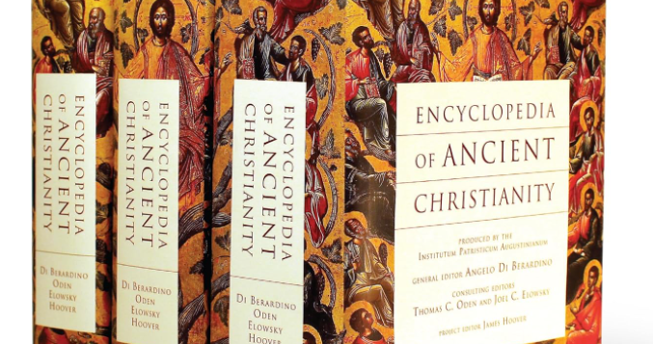

Slide 35
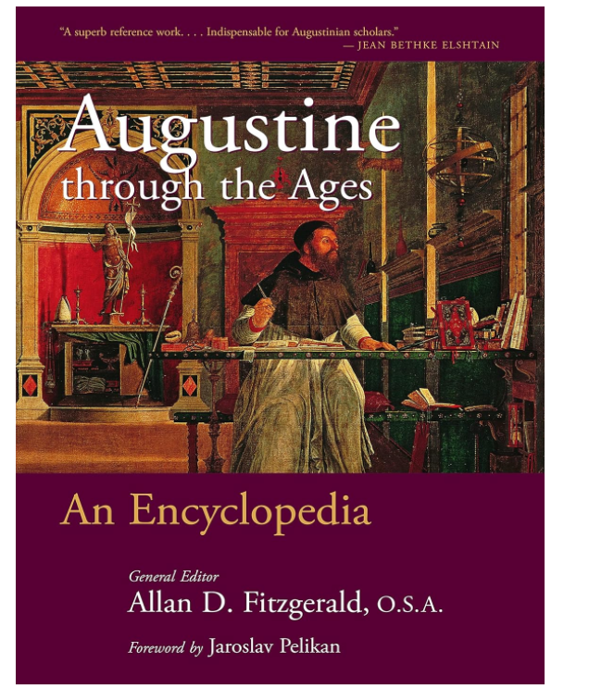

Slide 36


Slide 40
Pastoral Theology :
Useful Reference Books
Dictionaries & Encyclopaedias

Slide 41
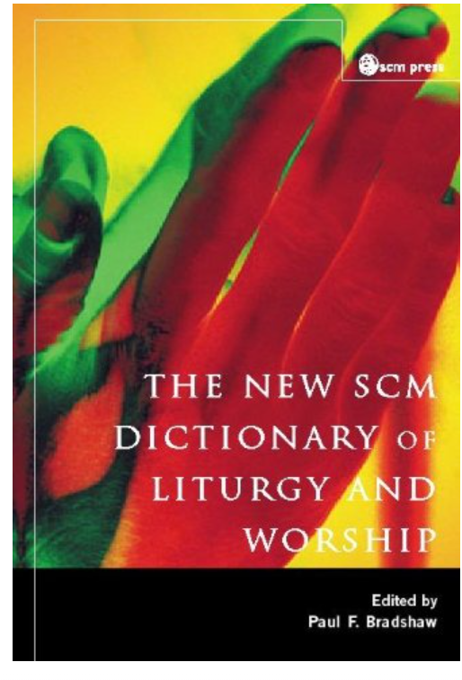

Slide 42
