Slide 1

Accessing Perlego
Perlego is a collection of almost 1m eBooks.
Our licencing terms mean that only Faculty and UTC students can access the resources in Perlego.
(You can find Perlego eBooks by two methods.)

Slide 2

There are two methods for finding Perlego eBooks
#1 When you search in Revelation Revelation your results will be limited to a curated subset of titles which we have integrated because they are eBooks about Religion and Theology.
#2 You can also search the very large, general collection of 1 million titles via the Perlego logo on the Library home page.

Slide 3
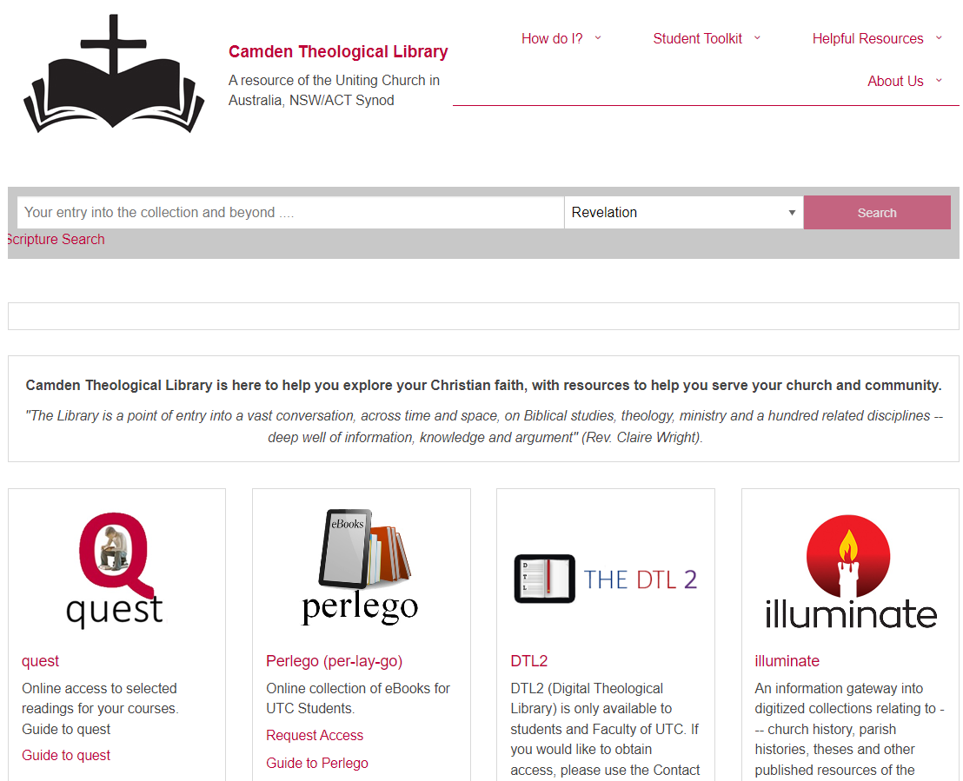
You can carry out a keyword search in Revelation or enter Perlego directly via the Camden Theological Library website home page
Notes:
Entering Perlego via to Camden Theological Library website/home page

Slide 4
Whichever method you use to find a Perlego eBook,
you will need to contact the Library to obtain
permission.
It is important to follow the instructions in the
following slides so that you are not charged for
using Perlego.

Slide 5
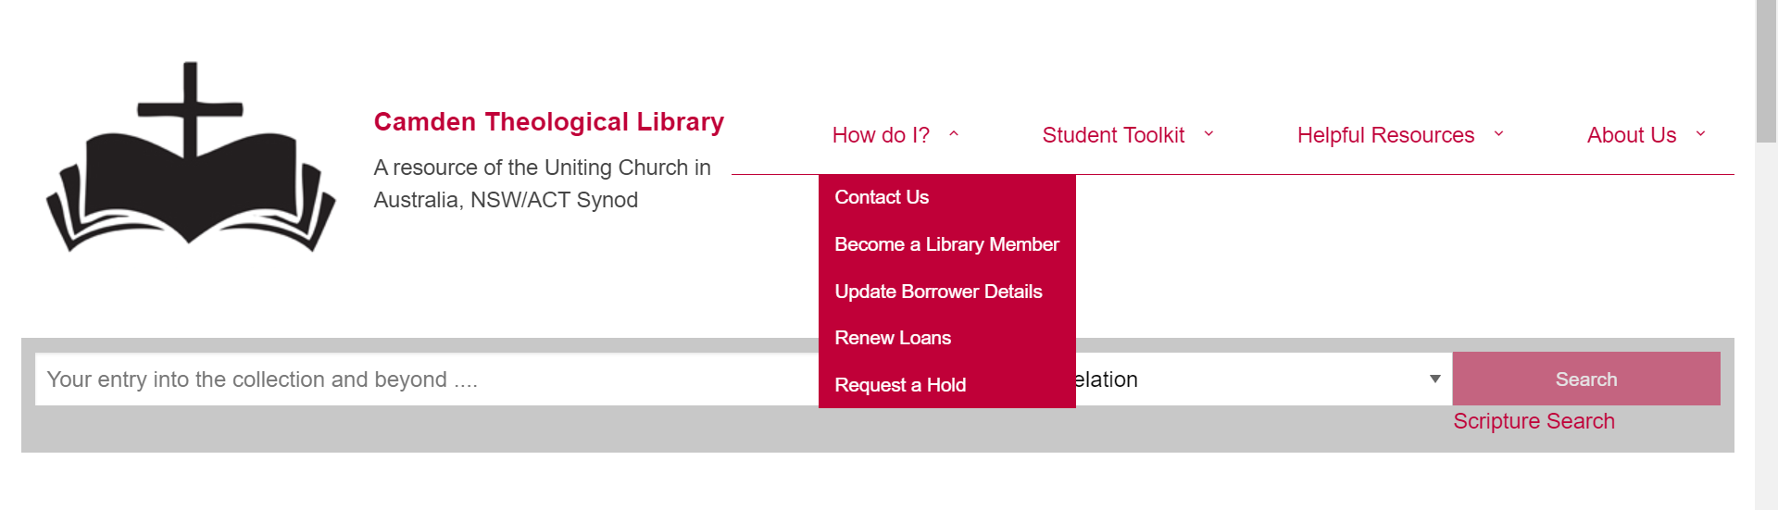
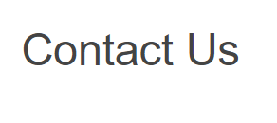
If you have not requested access to Perlego, please send an email via the Contact Us form on the Library home page, asking for instructions to be sent to you.
https://www.library.nsw.uca.org.au/contacting-us/contact-us

Slide 6
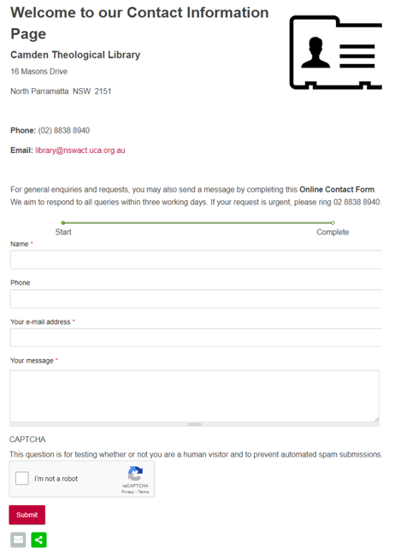
Contact Us
Please complete the form stating you wish to access Perlego.
Once this form has been submitted, Camden Theological Library will send you a URL via your email to enable you to set up an account in Perlego.
Follow the steps below and you will then be able to access the eBook.

Slide 7

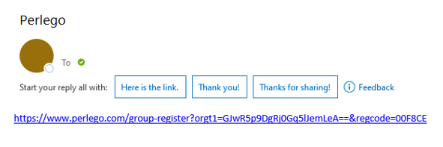
Firstly, go to your email and click on the Perlego link that has been sent to you.

Slide 8
Once you have received the email, click on the link which will redirect you to Perlego’s website to complete the sign in process
See next slides for images of what the correct sign in process is like. Make sure to complete each step

Slide 9
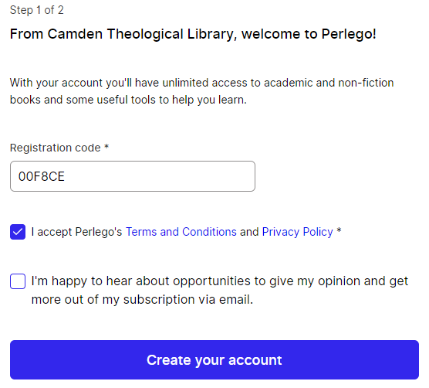
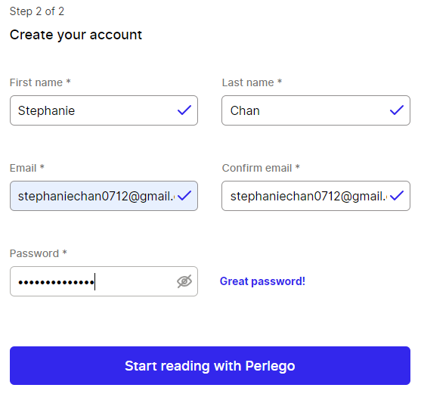
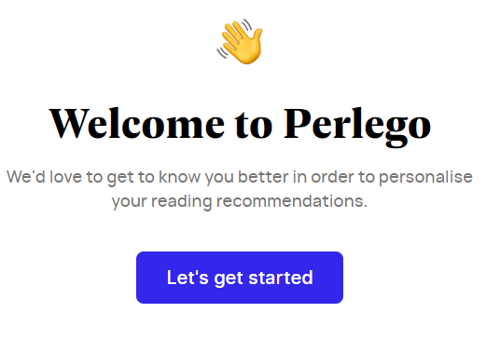
Complete each step to create your account - using your personal details - name, email and create your own individual password.
Welcome to Perlego!
1.
2.
3.
Jane
Doe
janedoe@gmail.com
janedoe@gmail.com

Slide 10
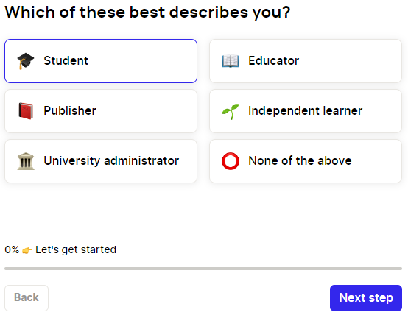
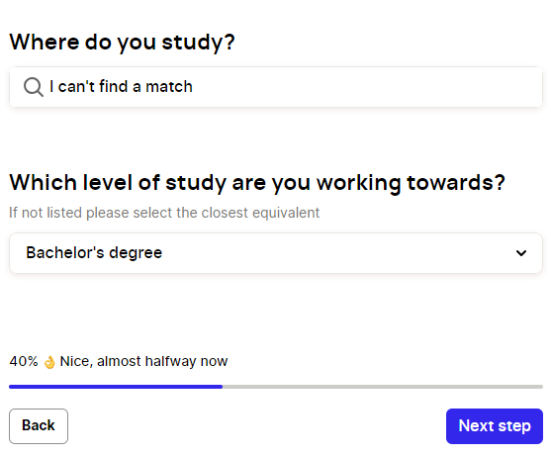
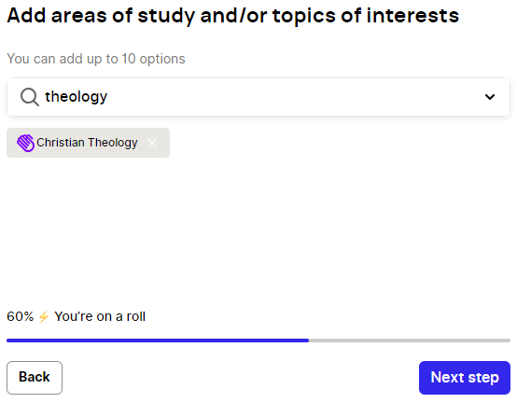
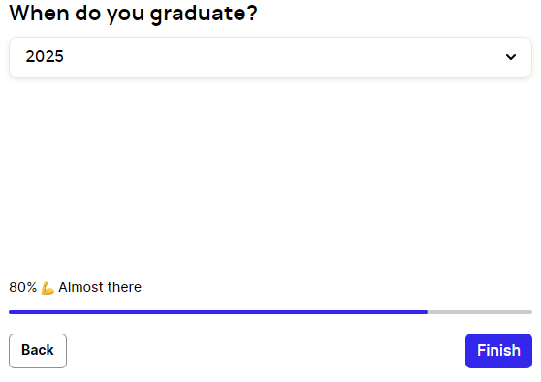
4.
5.
Remember to fill in all steps as indicated here
6.
7.

Slide 11
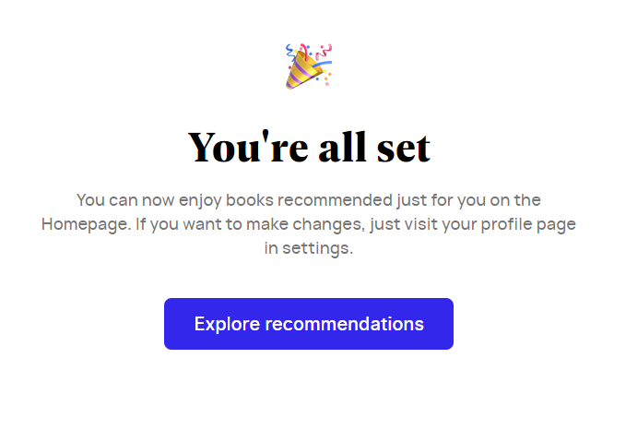
Great! You have now signed up to Perlego and can begin to access eBooks.
Remember to write down your Perlego login details so you don’t forget!

Slide 12

Would you like more Help?
Notes:
Would you like more Help?

Slide 13

We hope this has provided you with an overview of how to access eBooks from Perlego. Please contact the Library if your need some additional assistance.
Email library@nswact.uca.org.au
Phone 02 8838 8940
You can contact the Library team by email or phone, and we will be happy to assist you

