Slide 1

This resource provides an introduction to locating and accessing Journal articles in ‘Revelation’
Searching for Journal articles
using Revelation
Notes:
This resource provides an introduction at the new version of ‘Revelation’, the way results are displayed and some new features which are available.
When you search Revelation you can locate Print books, eBooks and Full Text Journal articles.

Slide 2
Before you begin…
Please follow the series of slides about Searching Revelation to understand the basic knowledge you need to search Revelation

Slide 3
Revelation provides access to many resources.
When you search for Full Text Journal articles in ‘Revelation’, the results will be taken from several Collections which have been integrated in ‘Revelation’. This gives you a ‘one stop’ search experience.

Slide 4
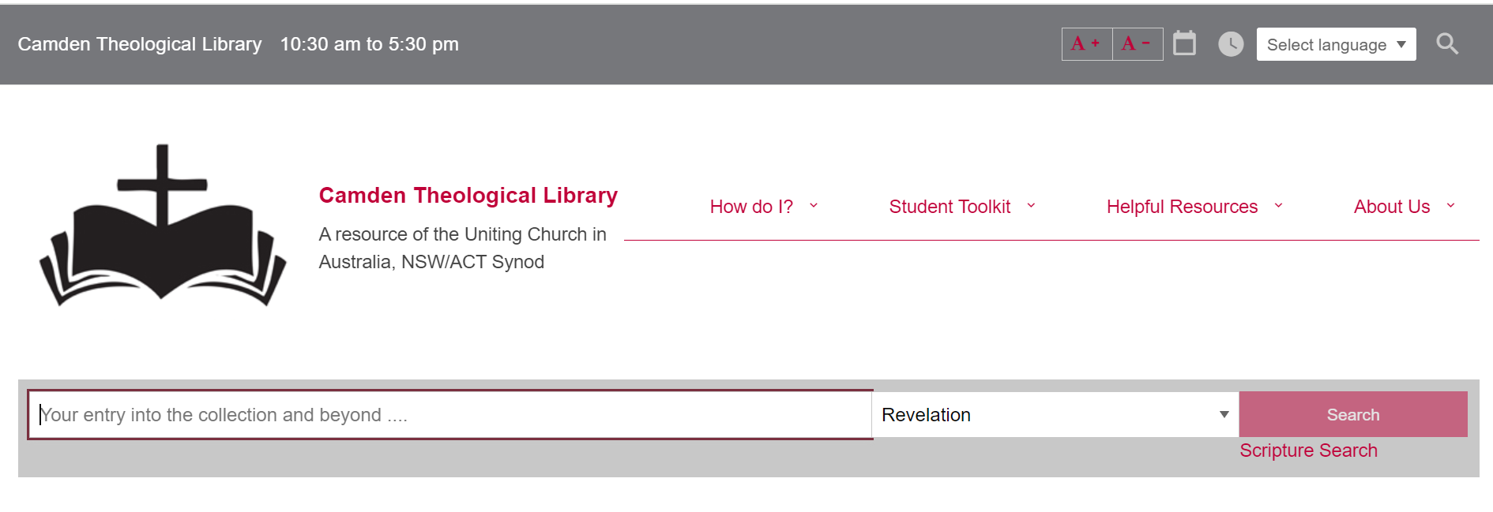
Access Revelation from the Library website https://www.library.nsw.uca.org.au/

Slide 5
You begin your search by typing Keywords in the Search box.
Keywords can be words from a Title, a Subject (Topic) or a combination of words from a Title and the name of an Author.

Slide 6
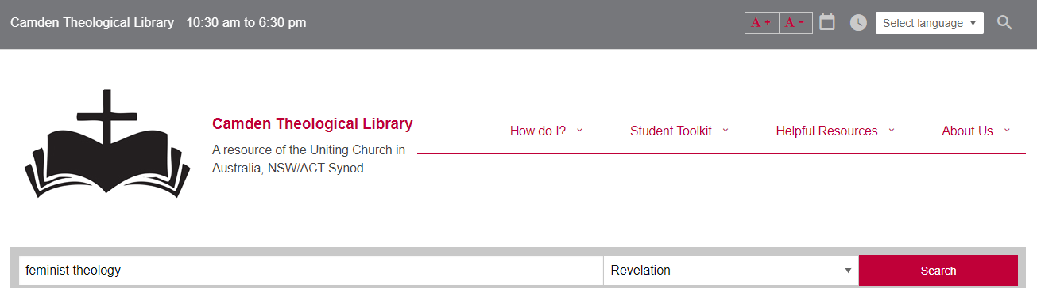
For example…
Enter your search terms (feminist theology) in ‘Revelation’
Then select ‘Search’ or press ‘Enter’
This will retrieve many results.

Slide 7
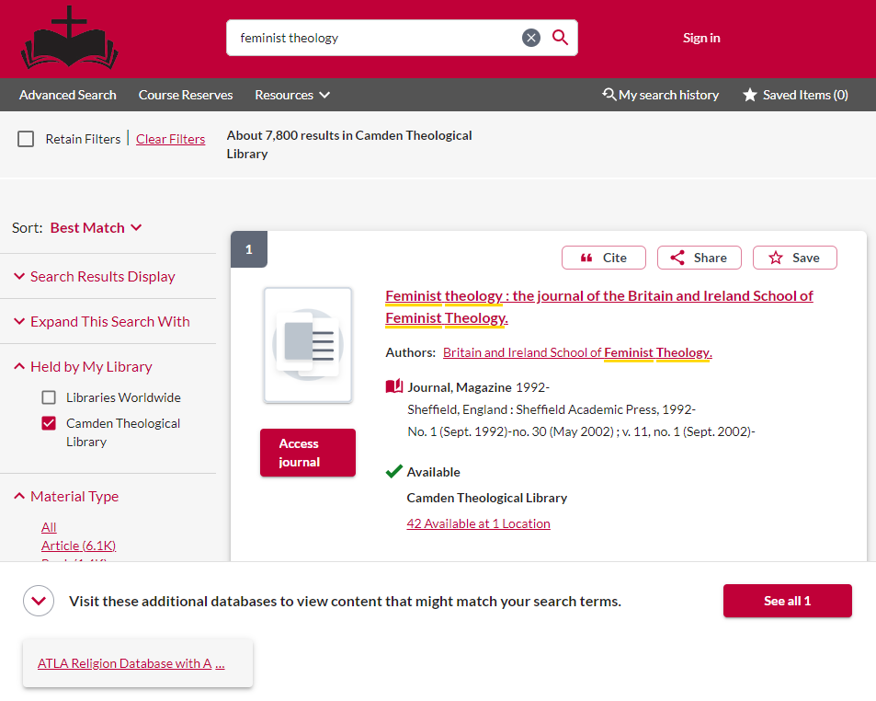
Limit the results to journal articles
There are several ways in which you can then limit the results to journal articles.
This is the simplest way:
#1 Click on the link at the bottom of the screen which will take you immediately to relevant journal articles in the ATLA Religion Database

Slide 8
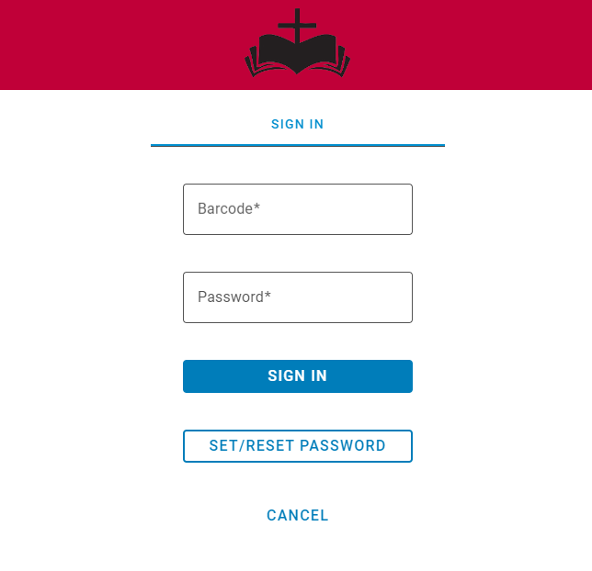
When you are asked to log in via this screen:
Enter your Library barcode and your password and click Sign in.
If you have forgotten your password, you can reset it. You will receive instructions via an email.

Slide 9
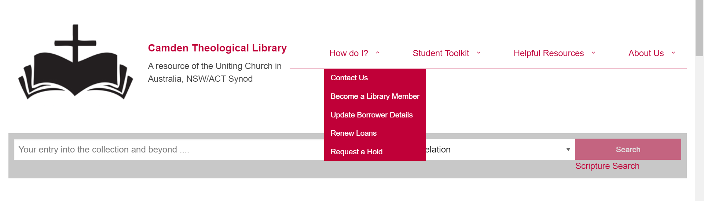
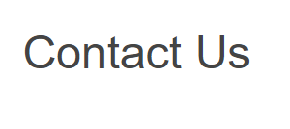
If you have not set up a Password, please send an email via the Contact Us form on the Library home page, asking for instructions to be sent to you.
https://www.library.nsw.uca.org.au/contacting-us/contact-us

Slide 10
1 Publication Date
2 Source Types
3 Subject
In the LH column of the results, there are some options to limit the results by -

Slide 11
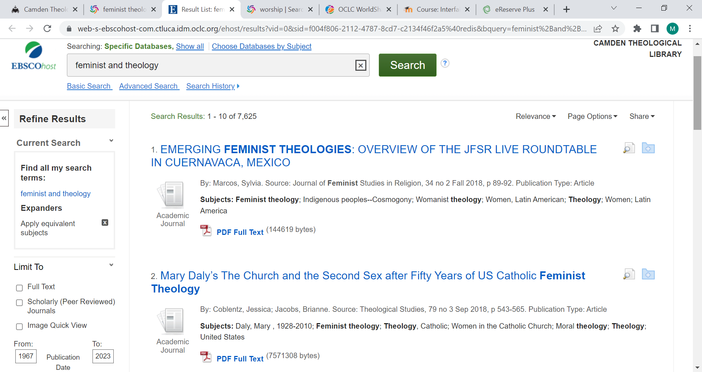
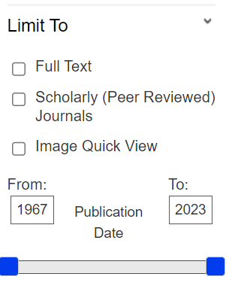
1 Publication Date

Slide 12
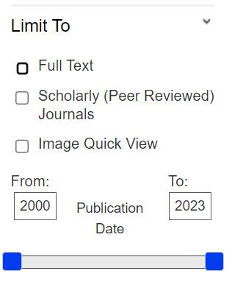
You can limit the date by changing the years in the From/To boxes
You can also limit the date by moving the slider bar

Slide 13
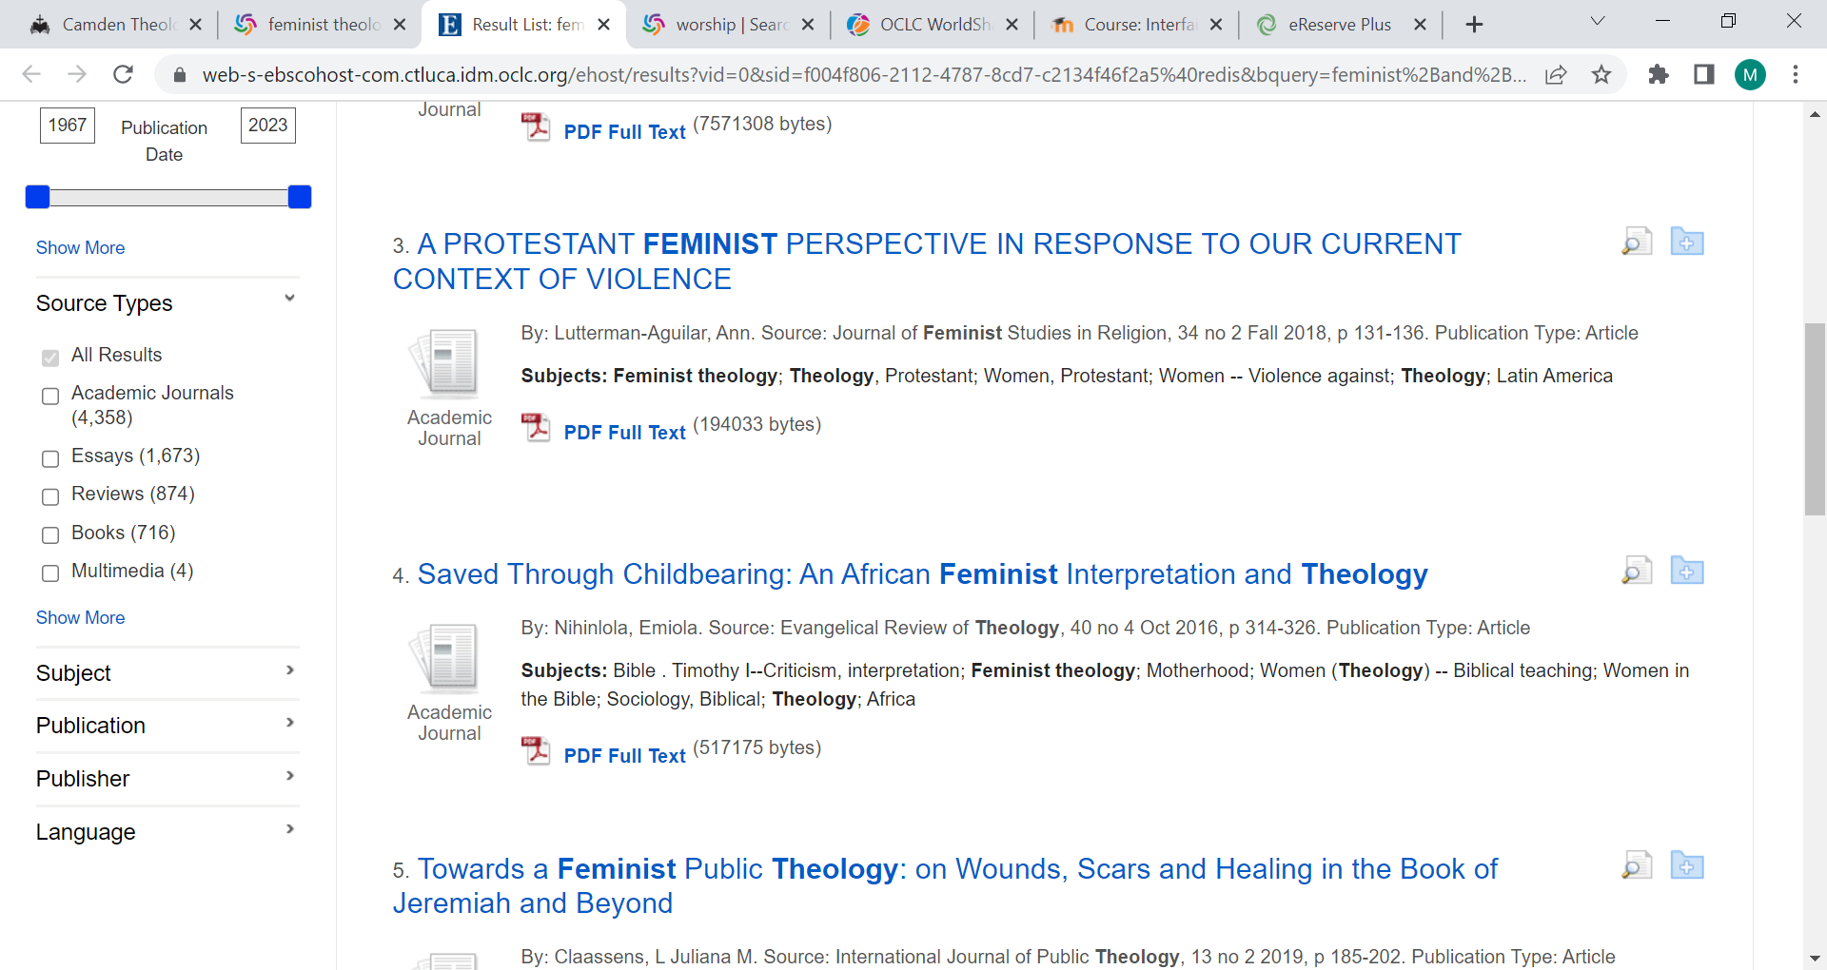
2 Source Types

Slide 14
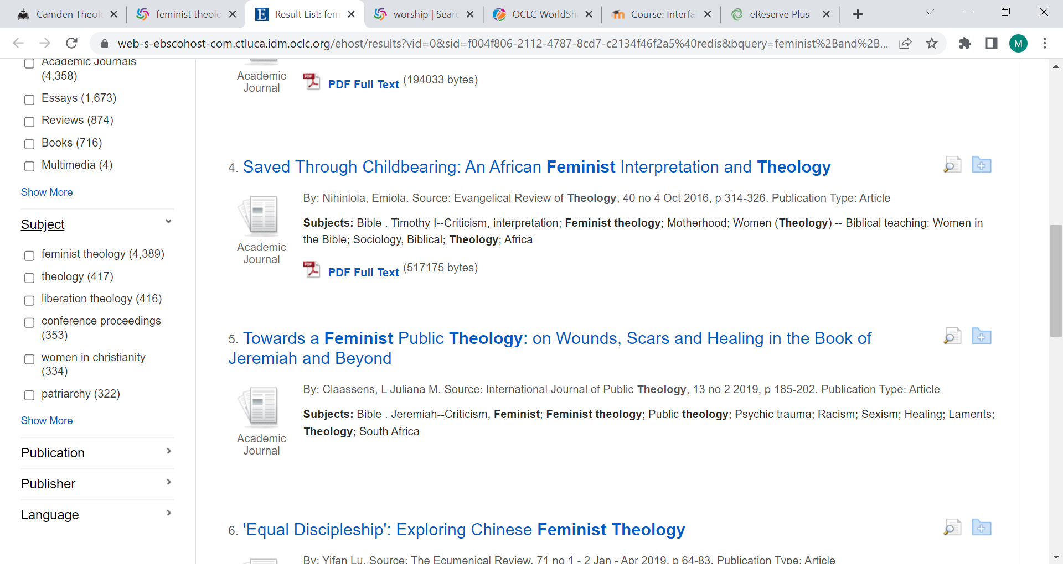
3 Subject

Slide 15
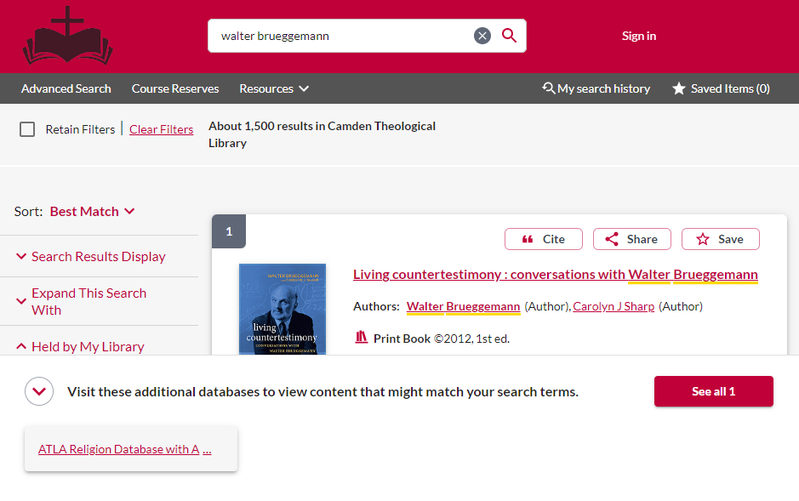
You can also search for Journal articles written by a specific author

Slide 16
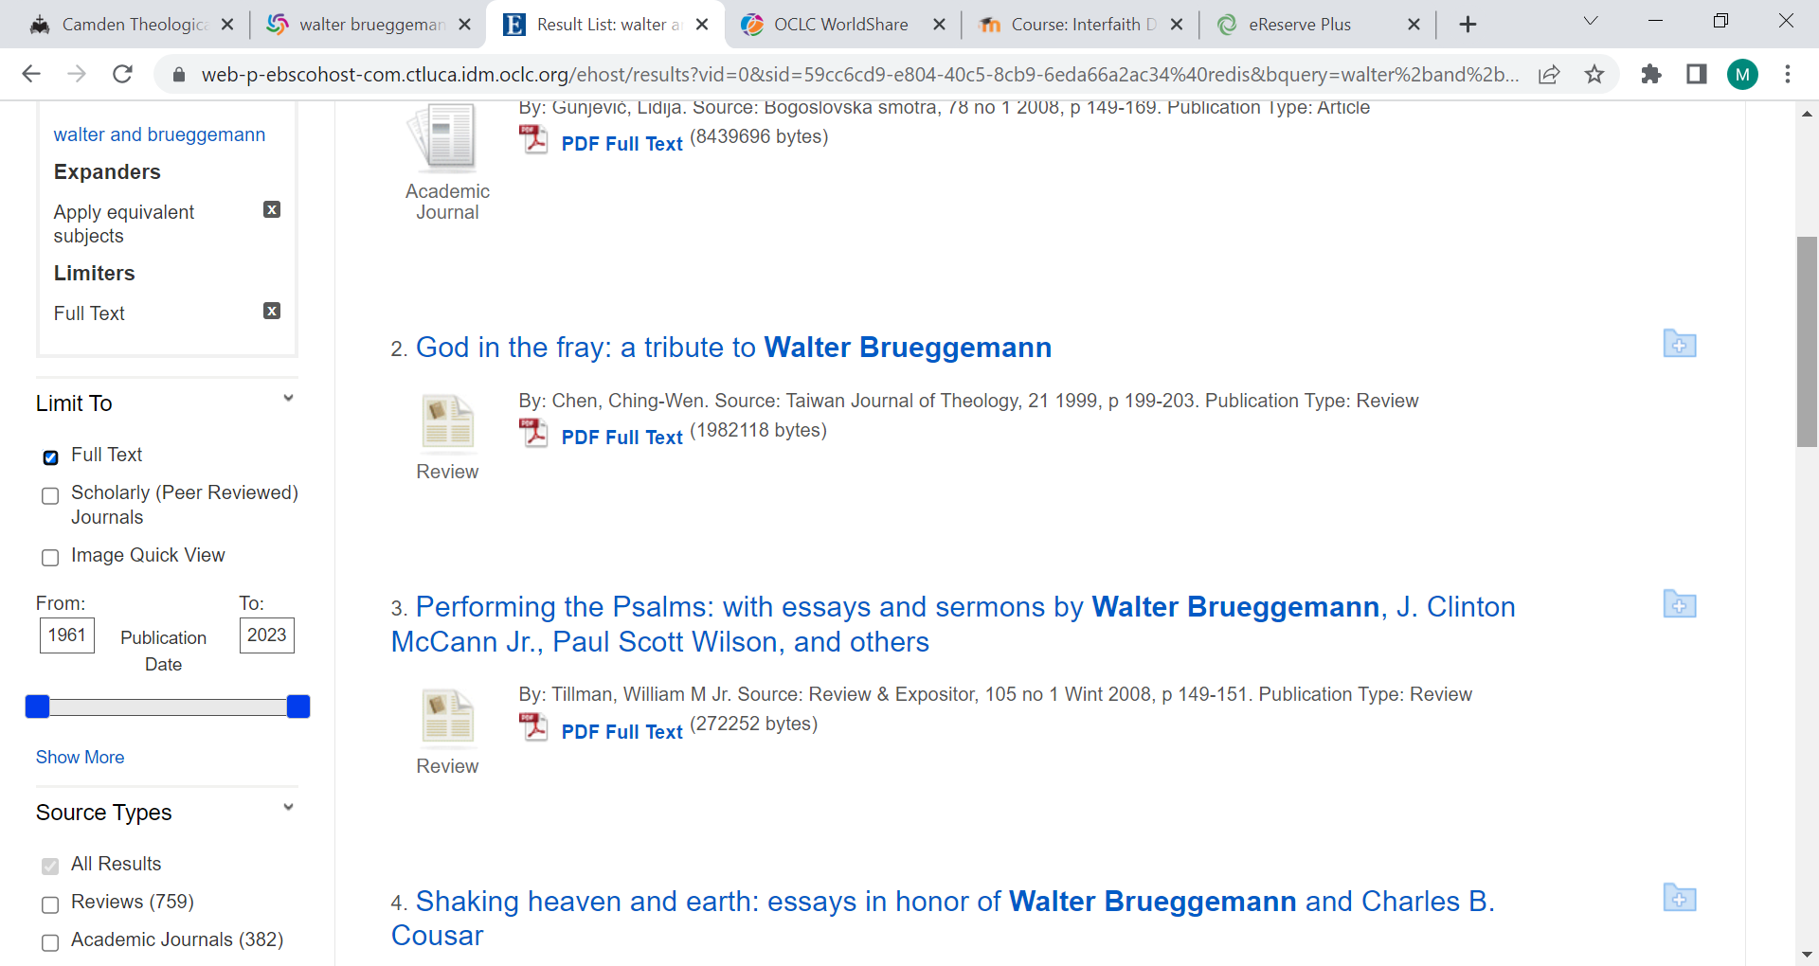
Again, you can use the link to ATLA Religion Database to find journal articles written by or about him.
If you limit by Full Text this will provide you with access to relevant articles

Slide 17
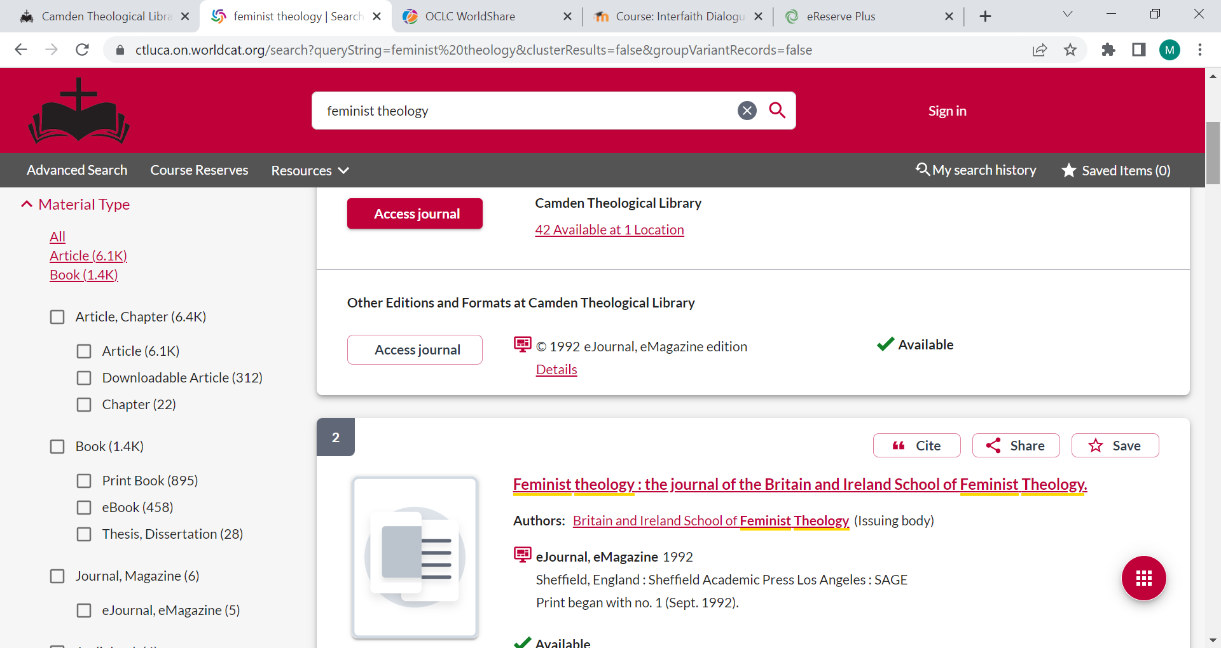
The Second way to find journal articles:
If you choose not to use ATLA Religion Database, you can use the Material Type limiter in the Left Hand column of the main results screen.
If you select Downloadable Article, this will enable you to access Full text articles.

Slide 18
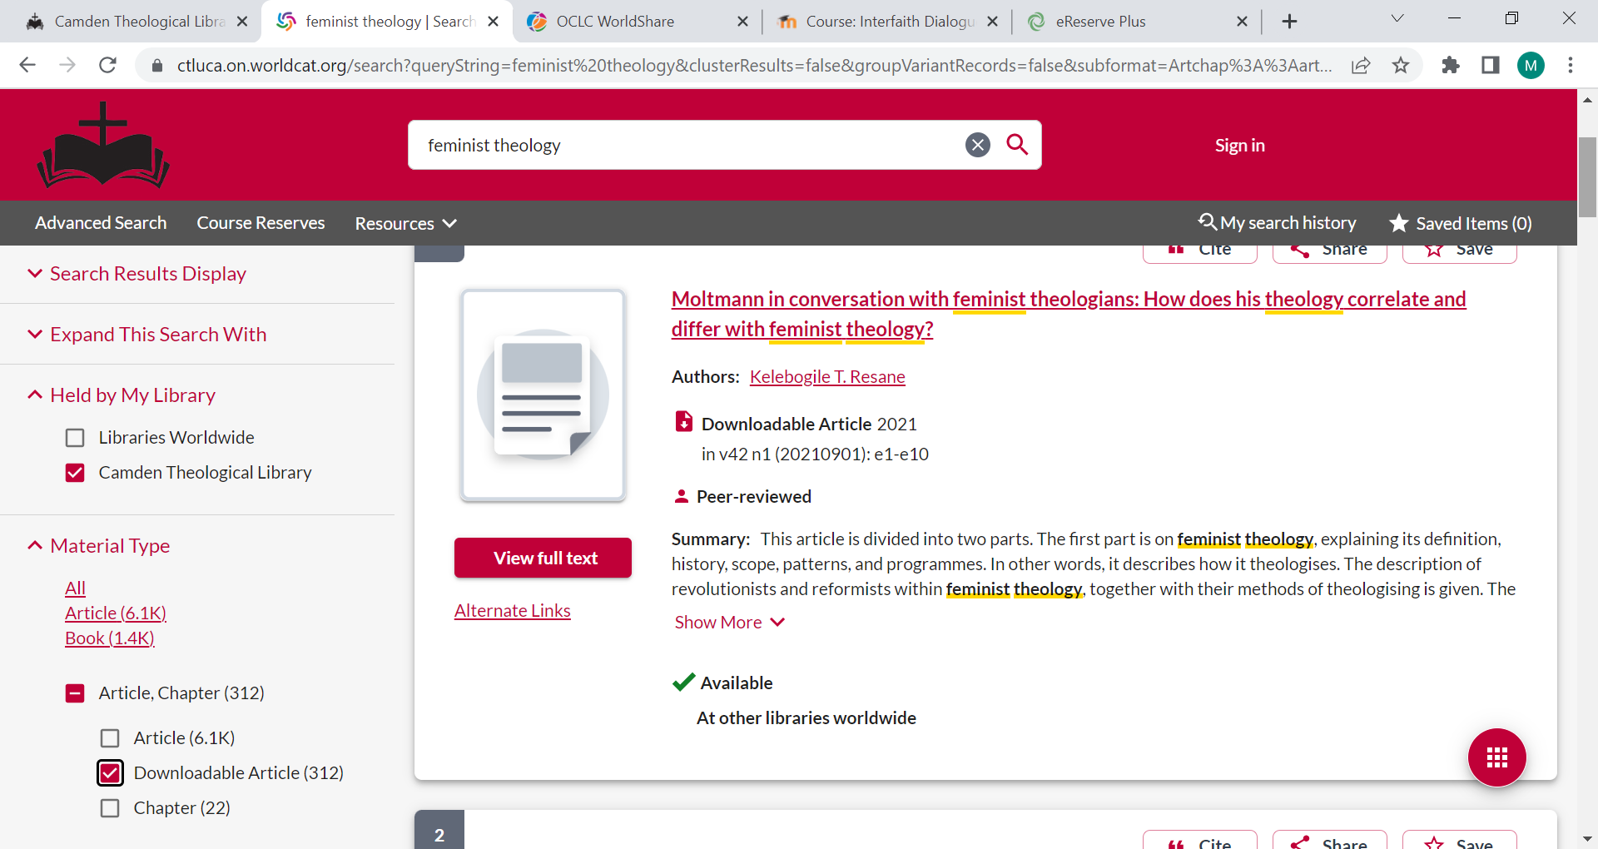
Click on Access Online or View Full Text and the article will be retrieved.

Slide 19
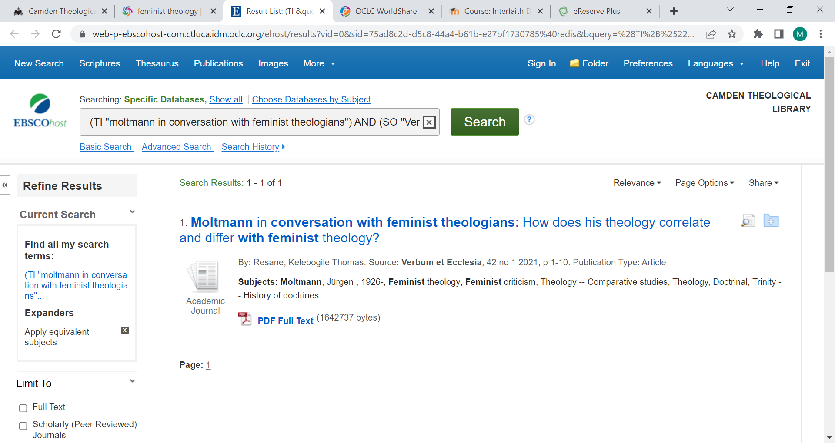
Click on
PDF Full Text to access the article
Some articles will require you to use DTL2 and a special code.

Slide 20
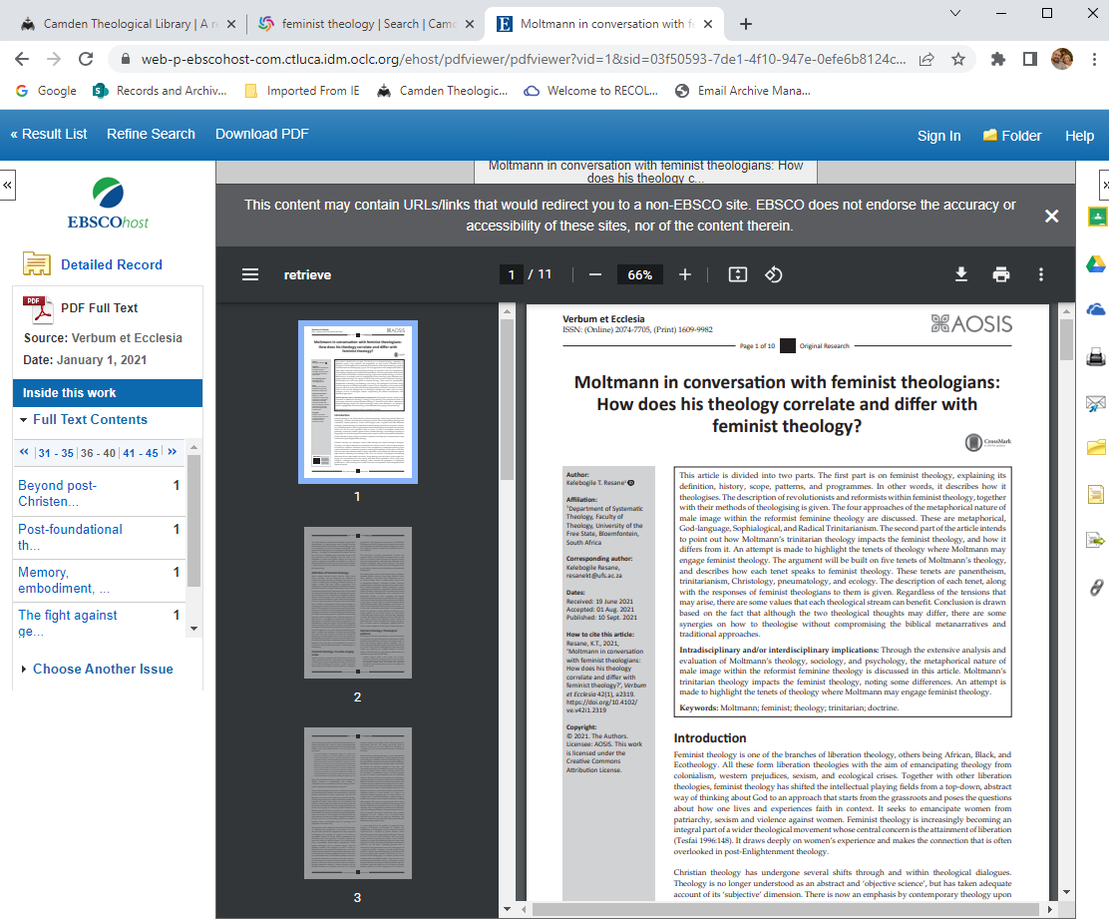
You can now view the PDF Full Text article

Slide 21

Would you like more Help?
Notes:
Would you like more Help?

Slide 22

We hope this has provided you with an overview of how to search for Journal articles in ‘Revelation’. Please contact the Library if you need some additional assistance.
Email library@nswact.uca.org.au
Phone 02 8838 8940
You can contact the Library team by email or phone, and we will be happy to assist you

